Slide 1
Study…! Share…! Grow……!
Digital solution for a guide to make the students capable of hopping into the corporate world
Domain : WEB DEVELOPMENT
Batch : C8
Kiruthika M (211417104120)
Sinthiya G (211417104260)
Vinitha P (211417104302)
Guide
Dr D Anuradha
CSE Department
Professor

Slide 2
Introduction
Collaborative Learning is a first of its kind which direct the students towards their goal to make them fit enough the current industry demands.
In this platform students are able to find the path towards their goal. This platform is tracked by a counsellor from the day one , who is having his best of the knowledge on the current needs and trends.
This platform also cultivate the quality of up skilling themselves by knowledge sharing. This quality is now a days are cultivated in many company by placing instructors.

Slide 3
Literature Review
Title | Journal | Objective | Key features | Observation
Learning Management System (LMS) Success: An Investigation Among the University Students Year 2015 Author Seyed Mohammadbagher Jafari , Suha Fouad, Mohaddece Sadat Moaddab, Sharif Omar | IEEE | This study is an attempt to investigate the factors influence the success of LMS. Research model was developed by examining the relationship between students’ outcomes (perceived usefulness) and information quality, system quality, and readiness for online learning through system use and user satisfaction. | This project consist few disadvantages: This paper consist of data which has been collected in only one university So we can not guarantee that it is applicable other universities. | In project reduces the time and cost when compared with normal schools and university. There is no limitation to number of student user at particular time. Student can access /view the quiz, study materials, assignments, videos, doubt clarifications and submit homework.

Slide 4
Literature Review
Title | Journal | Objective | Key features | Observation
A survey paper on e-learning based learning management system Year 2013 Author Chirag Patel, Mahesh Gadhavi, Dr. Atul Pate | International Journal of Scientific & Engineering Research | This paper includes study of numerous e-learning based learning management systems(LMS). Each system is classified as per the parameters such as technology, features and platform-tools. Base on these parameters a new unified cloud based system is proposed with all these parameters and other new features. | Automatic assignment evaluation with integration of plagiarism detector and keyword matching Web-based virtual workshop management Single sign on | This paper is for rural area people who is suffering to study in their own place. This paper is describe fully about a cloud based learning system

Slide 5
Literature Review
Title | Journal | Objective | Key features | Observation
Web-based Learning Management System Considerations for Higher Education Year 2013 Author Chih-Hung Chung, Laura A. Pasquini, Chang E. Koh | International Journal of Scientific & Engineering Research | The purpose of this study is to present a model which incorporates the concepts and findings from research on LMS application in higher education. The alternative model was modified based on the TAM. This study provides several recommendations including a model of development and design of an LMS for future implementation in higher educational environments | Transmitting course content Evaluating Students Evaluating course and instructors Creating class discussion Creating computer based instructions In addition to midterm exam, course information, article reading and specific task. | This paper is made only for higher education and this is modified based on technology acceptance model (TAM). This paper gives a solution of unlimited distance education with flexible learning timing.

Slide 6
Literature Review
Title | Journal | Objective | Key features | Observation
Online Learning Management System Year 2015 Author Zheng Ninghan, Tian Shuzhen, Chen Yongqiang | IEEE | This paper is about a online teaching management system called Tsinghua University Online Judger (THUOJ). In this article, the author made his design according to the potential users of the system, and proposed a design of the system’s structure on the basis of the frame using Linux+Apache+MySQL+PHP(LAMP). | This project consist of 4 processes Process a - Profiling preprocessing section Process two - Profiling compilation section Process three - the operative part of the evaluation function Process four - Profiling answer judgment section | This project is for coding test (eg:HackerRank). Especially, the author adopted C and PHP to program the online judge module. Finally, there is a simple website demo has been implemented on the basis of OJ module, in order to demonstrate the usage of proposed system and online judge module

Slide 7
Problem Statement
Colleges, today considered as a stepping stone into the massive corporate world. In addition to top class education they have the responsibility of providing quality placements in well established company.
Now they realised that there is an urgent need to take up the responsibility to make the student industry ready from day 1.
Though many college and institution have placement cells, the number of students that get placed is often low due to a multitude of reasons. Even after having placed students are unable to cop up with the expectations of corporate world

Slide 8
Reasons behind
Lack of knowledge and skill gap
No earlier analysis
Final Year preparation is not at all enough
Lack of tracking the path.
Manual tracking of each individual becomes difficult

Slide 9
MERN STACK
Browser : Google Chrome
Web Development Framework : Express.js
React.js - a client-side JavaScript framework
Node.js - the premier JavaScript web server
Programming Language : JavaScript
Protocols :HTML
Data formats :JSON (JAVA SCRIPT OBJECT NOTATION)

Slide 10






System Architecture Diagram
Collect data
Request
Web Server
( Contains app logic )
Display
Results
Response
what the users sees and interact with html,css,
javascript
( Frontend )
Files system
Database
( MySQL)
(Backend)

Slide 11
ER Diagram
Email
Address
Phone
Github
Email ID
Password
DOB
LinkedIn
Name
X details
Year
Personal details
Academic details
XII details
Has
Reg no
Login
Create account
yes
CGPA
College details
Contains
Year
Login
details
Backlogs
yes
Department
Resume
Home Page
New
password
Confirm
Password
Mark sheet
Skills
Profile
Achievements
Courses
Add Skill
Certificates
Placement
Project

Slide 12
Class Diagram
Login
Create Account
String Email_ID
String Password
Integer Year
Get_Personal_Details
Get_Accademic_Details
Upload_Resume
Upload_Certificates
College_details
Skills
Login_Details
Get_Email_ID
Get_Password
Verify_Password
Forget_Password
Courses
Recommemded_courses
Trending_courses
Skills_Display
Profile
Home Page
Display_Resume
Edit_Resume
Edit_Login_details
Report_Problems
Log out
Courses
Add_Skills
Profile
Placement_Details
Add_Skills
Placement_Details
Upload_Certificate
Rating
Review
Elegibile_companies
Current_opening

Slide 13



Use case Diagram
Personal Details
Create Account
Academic Details
Upload Resume
College Details
New Student
Skills
Login Details
Upload Certificates
Login
Email ID
Year
Reset Password
Password
<excludes>
Registered student
Forget Password
Home Screen
Profile
Add Skills
Courses
Placement
Admin

Slide 14
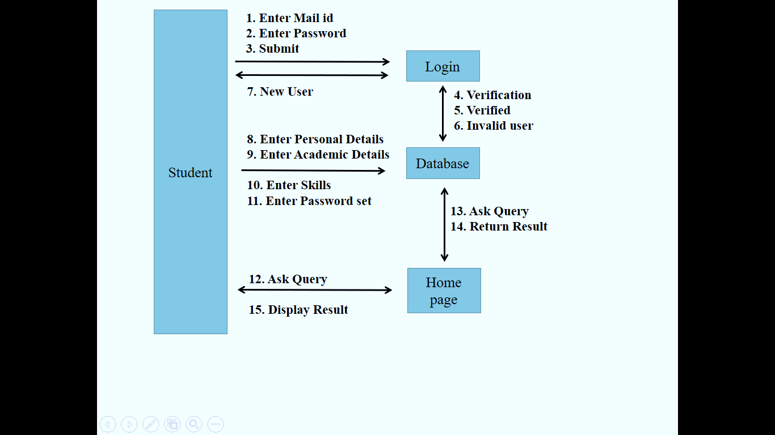
Collaboration Diagram

Slide 15
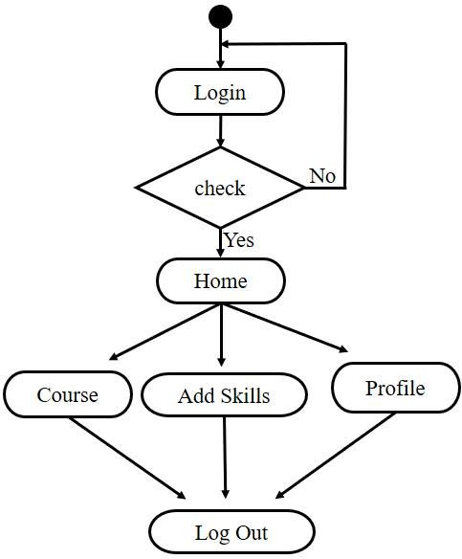
Activity Diagram

Slide 16
Project conisist of three modules
User Login
Admin login
Database storage(MYSQL)

Slide 17


Users
Guide
Student

Slide 18
Duties of students
Choose course
Upload the certificate
Share the reviews and experiences
Analyse his/her interested field

Slide 19
Duties of guide
Can view and maintain the profile of student
Recommends the courses for students
Add, Approve or Remove courses.
Provide details about placement

Slide 20
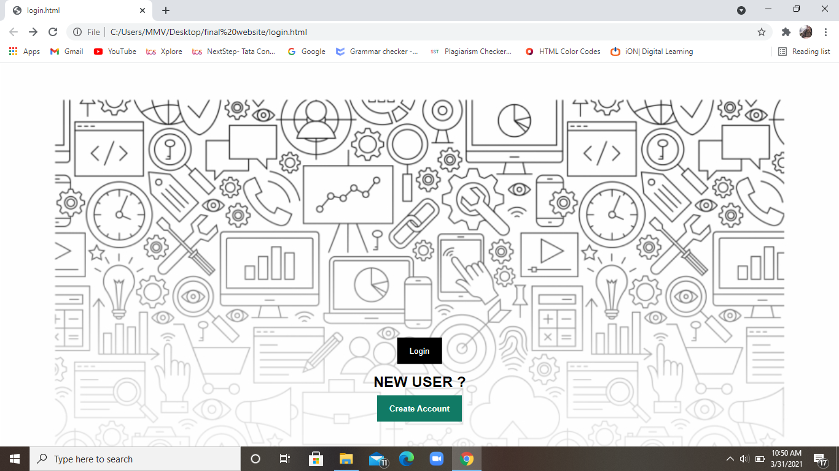
Project Output

Slide 21
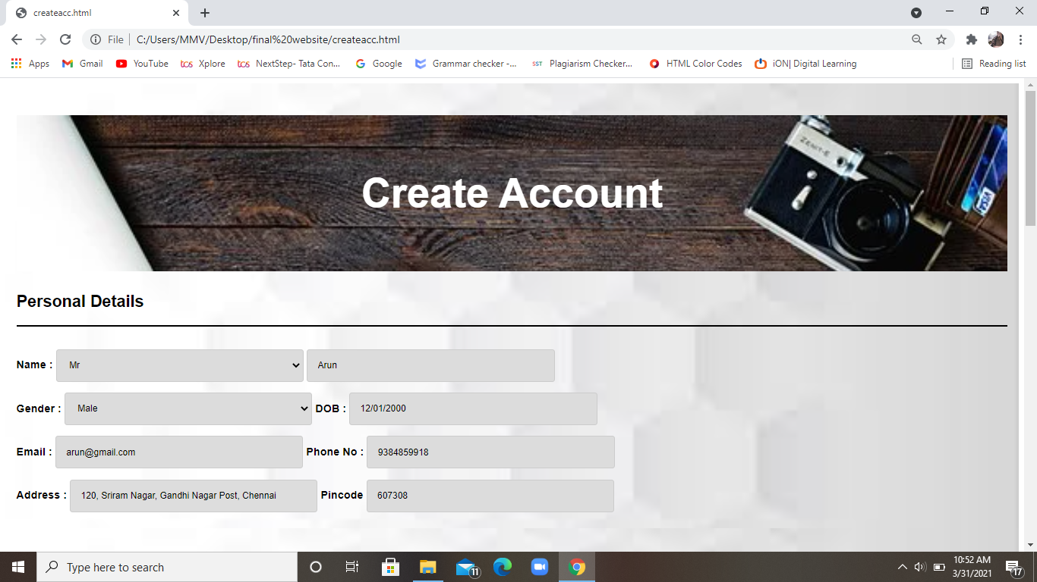

Slide 22
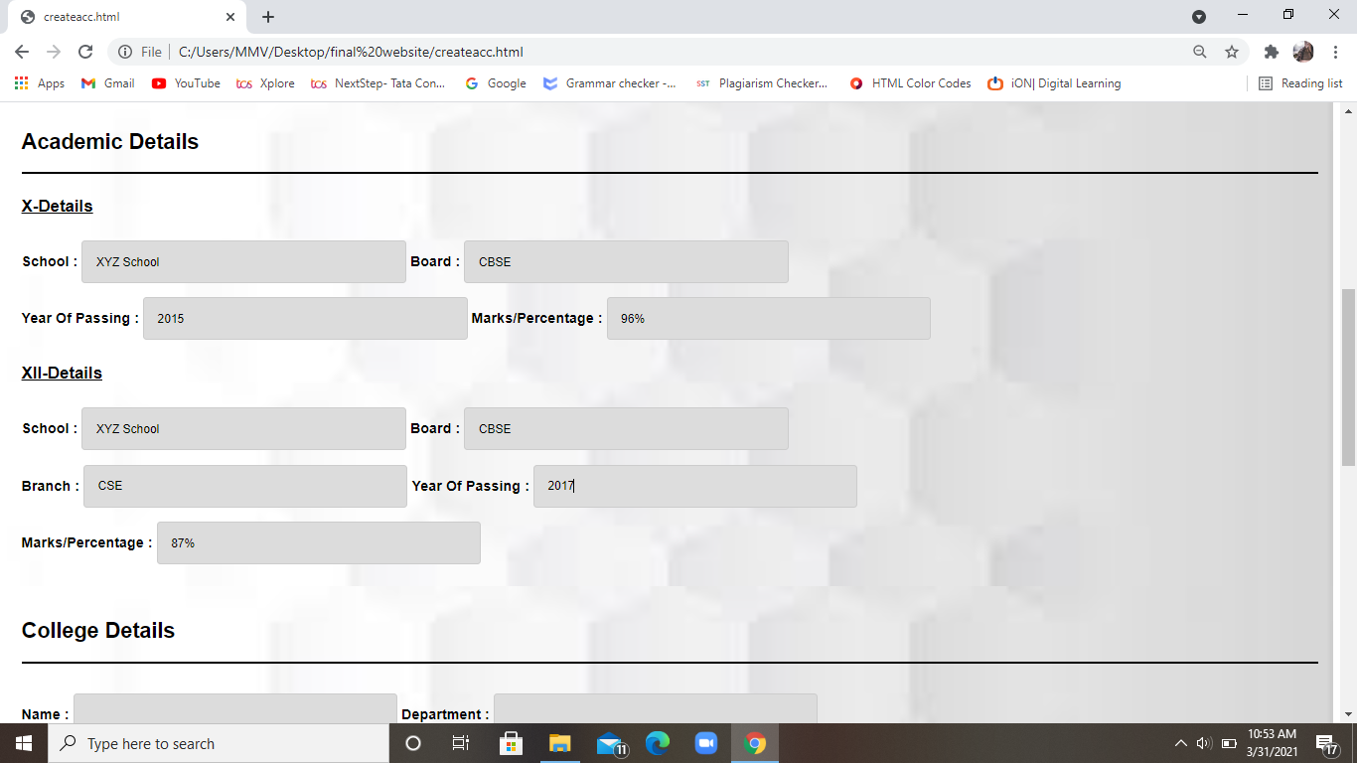

Slide 23
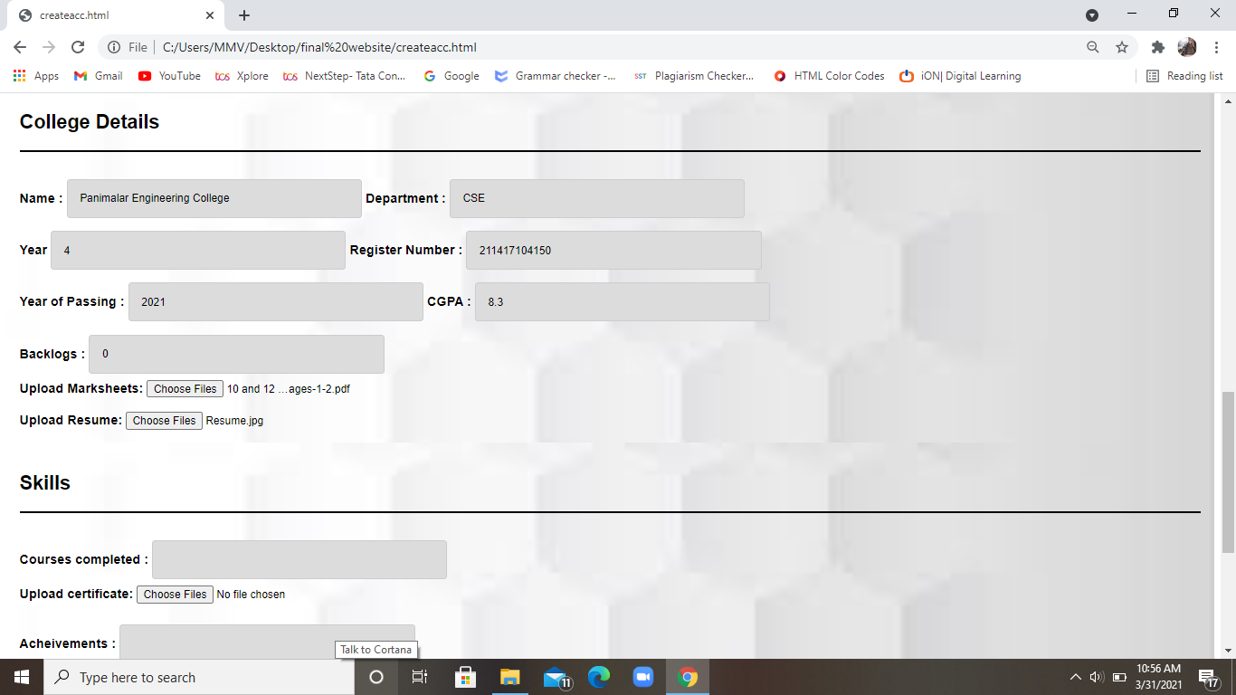

Slide 24
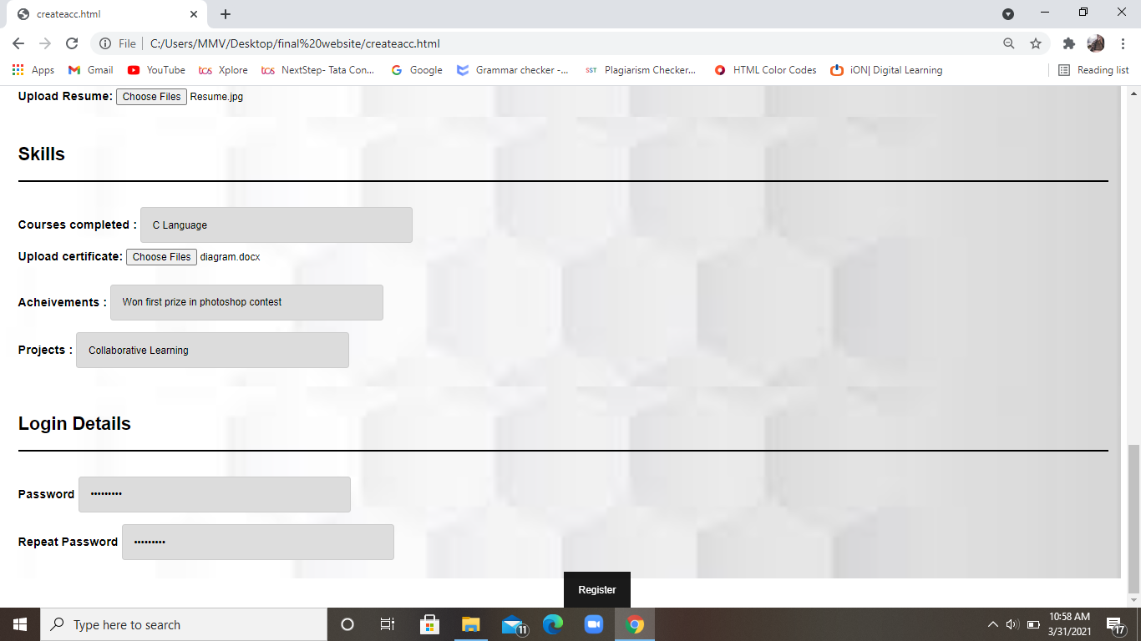

Slide 25
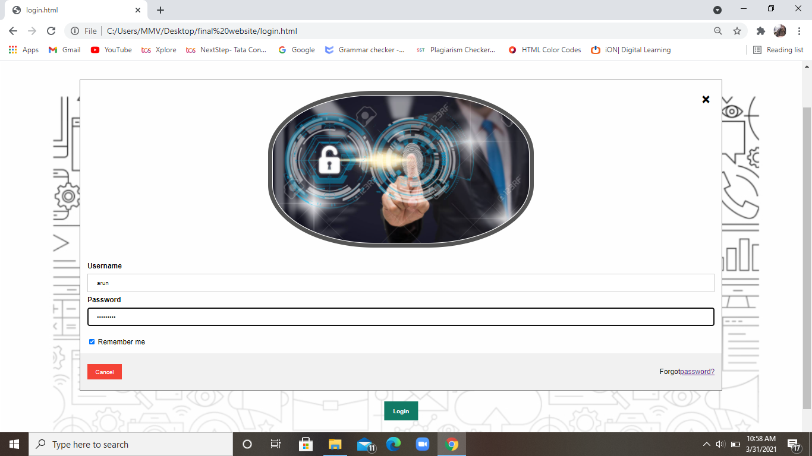

Slide 26
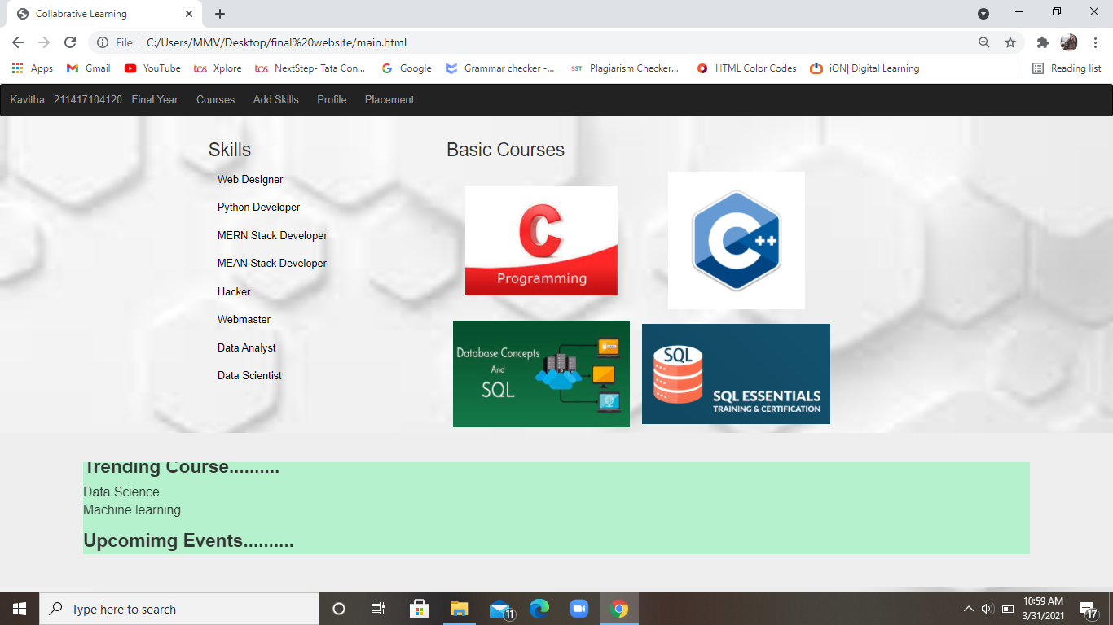

Slide 27
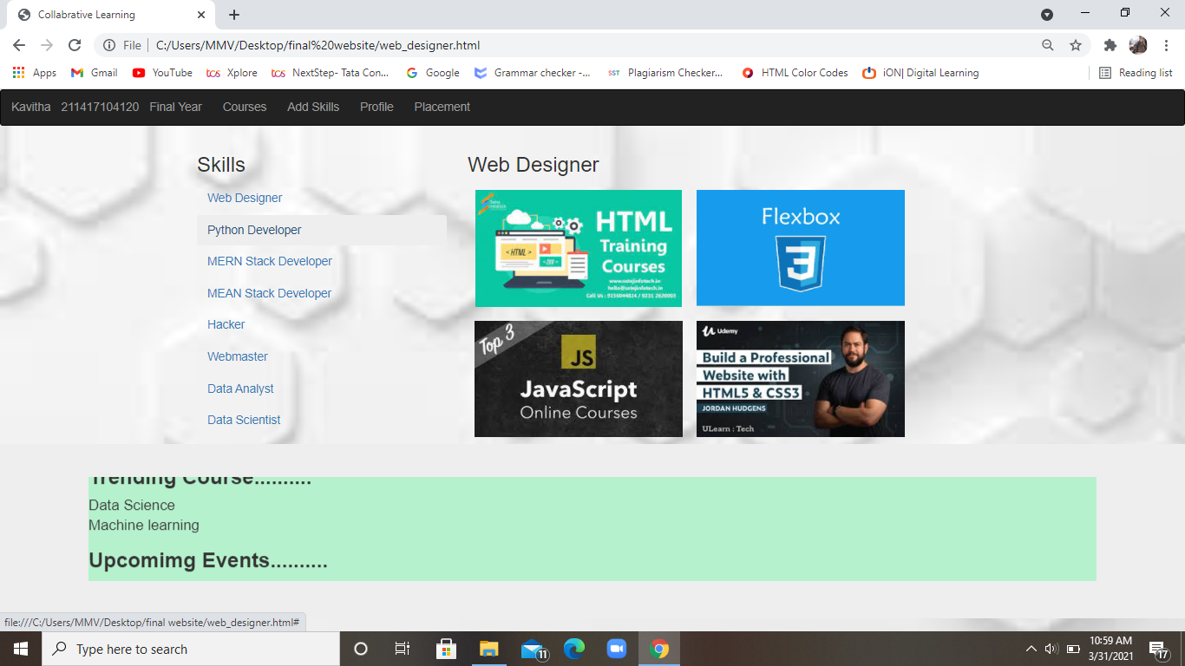

Slide 28
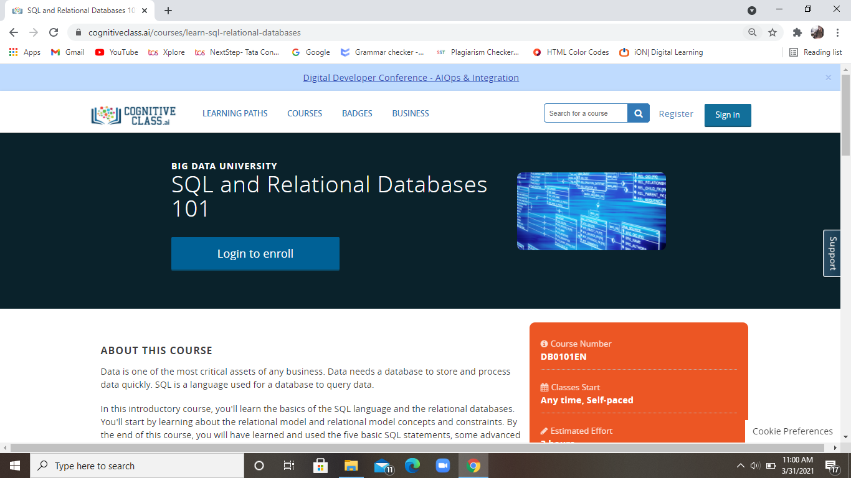

Slide 29
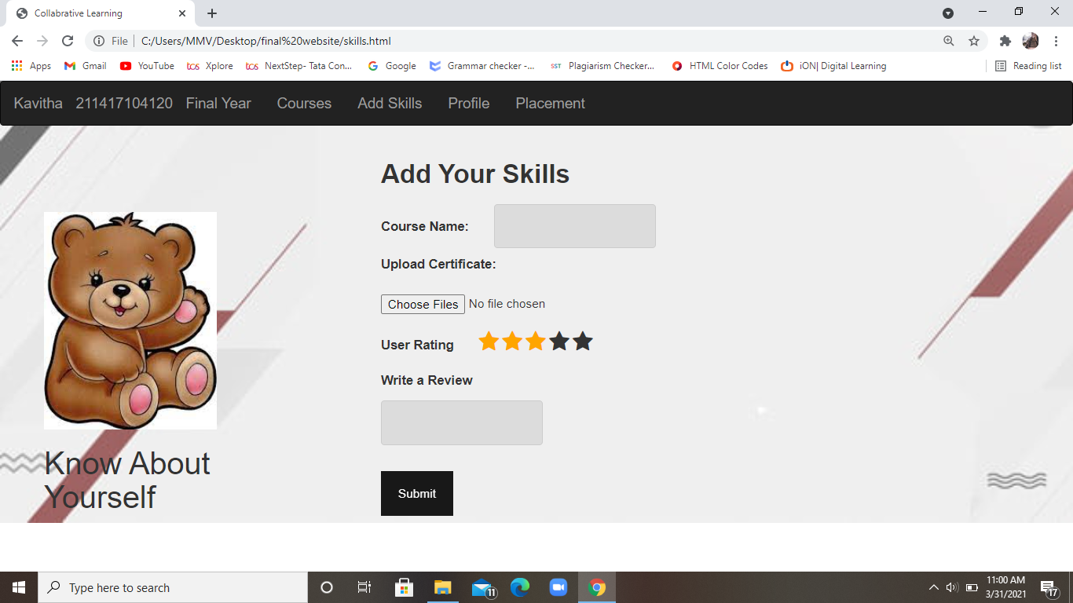

Slide 30
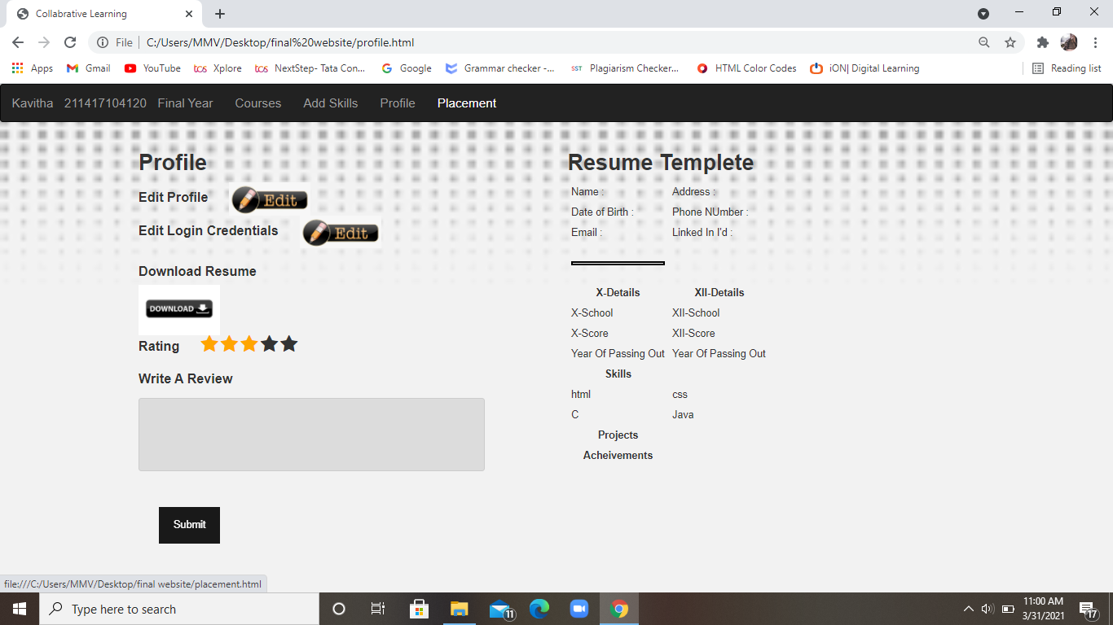

Slide 31
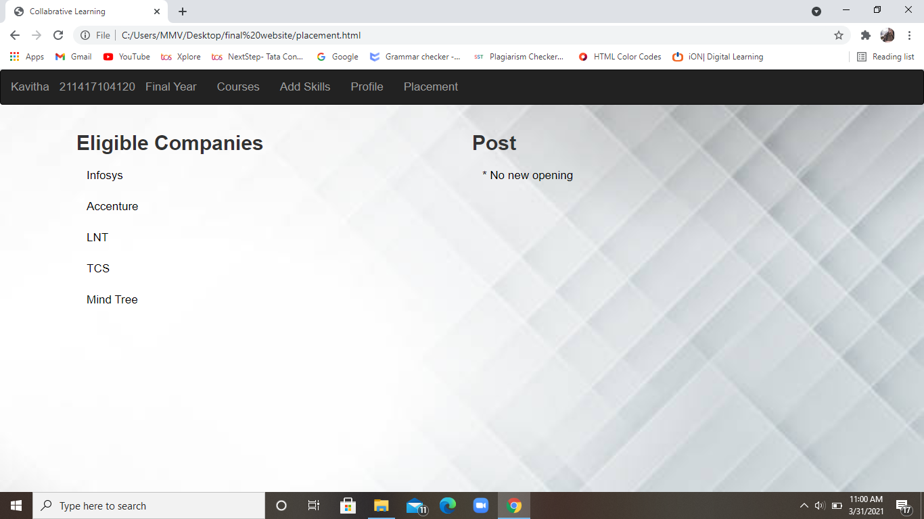

Slide 32
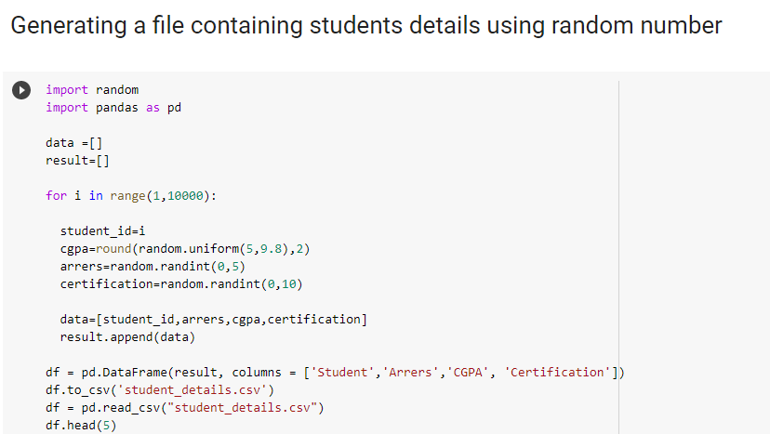
Admin end

Slide 33
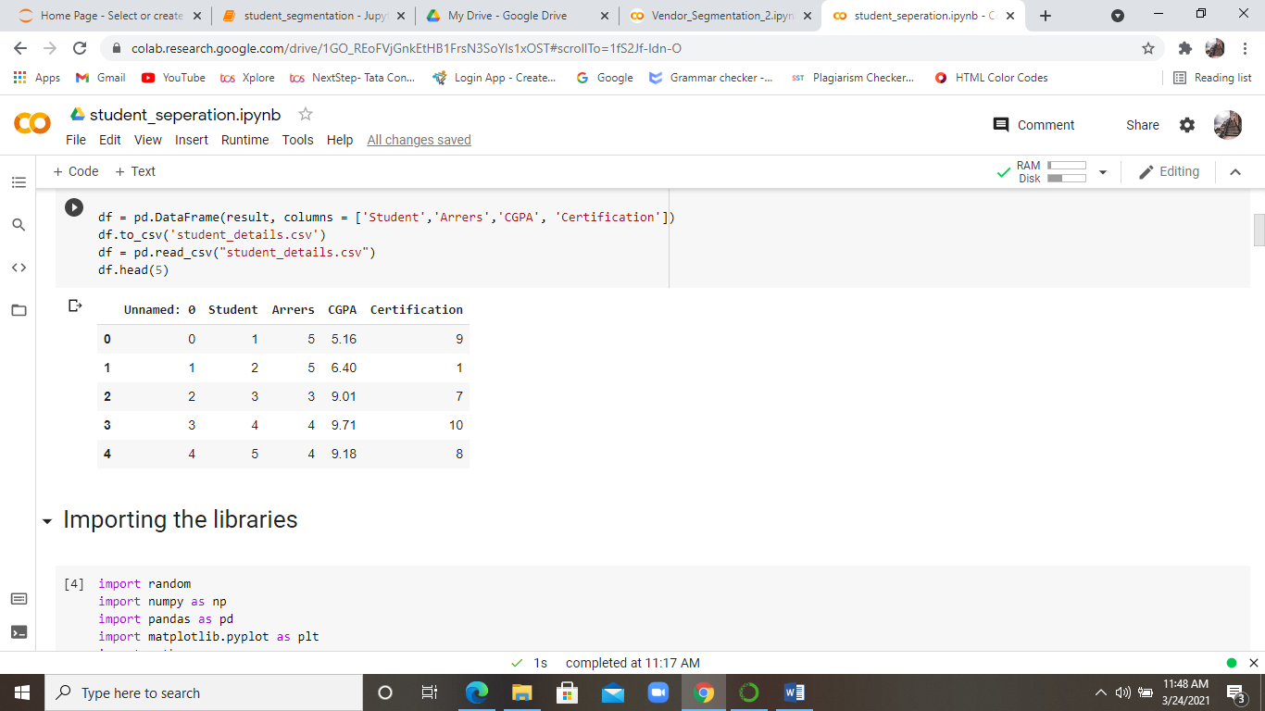
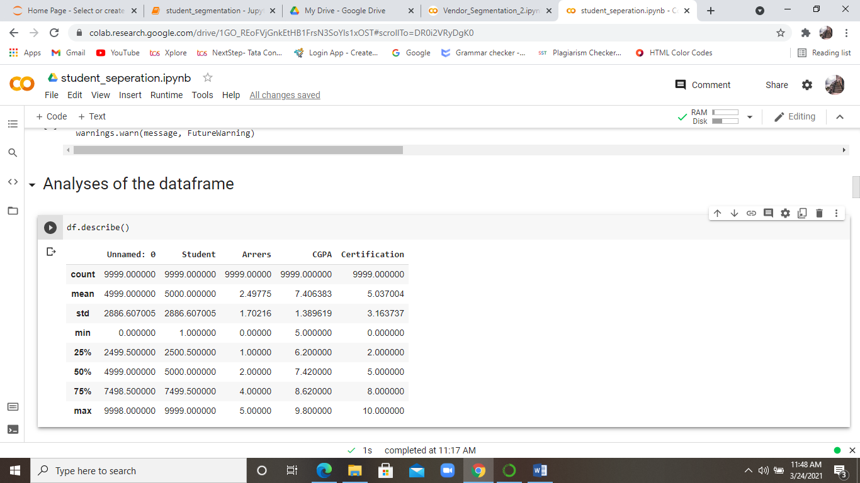

Slide 34
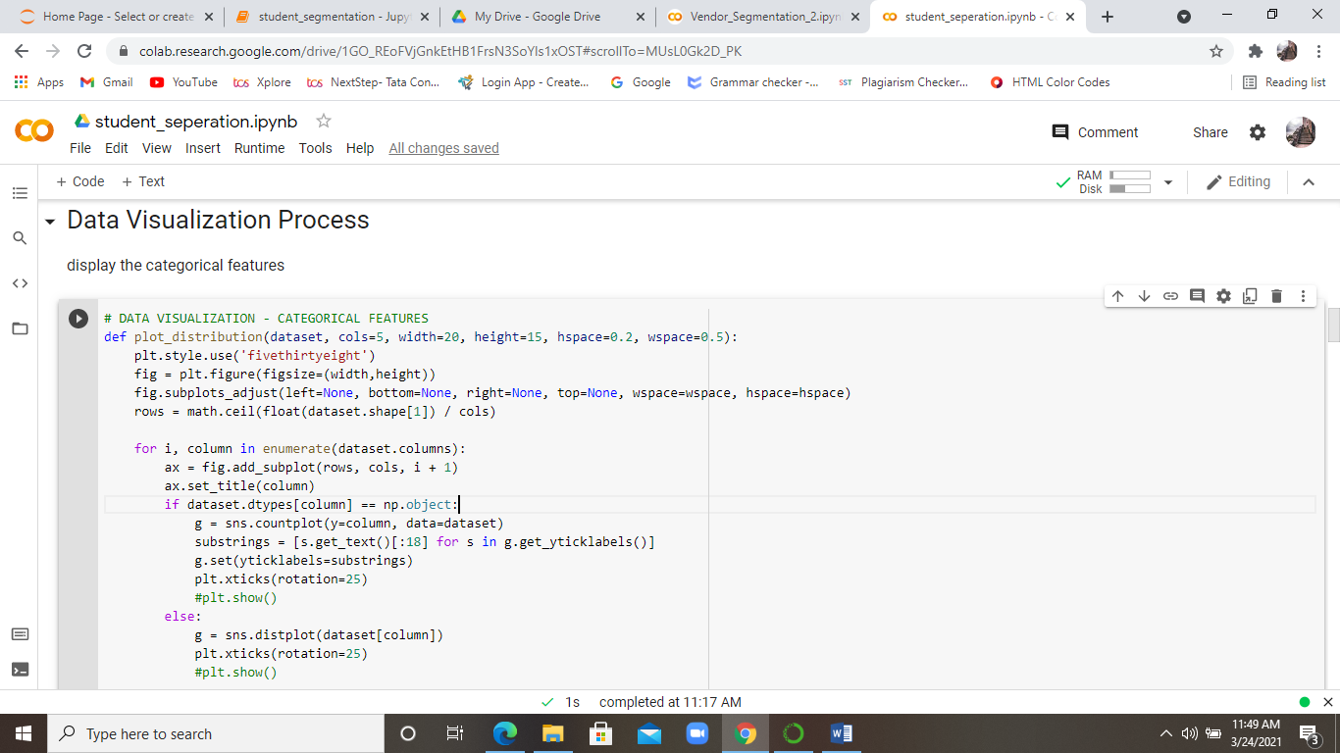
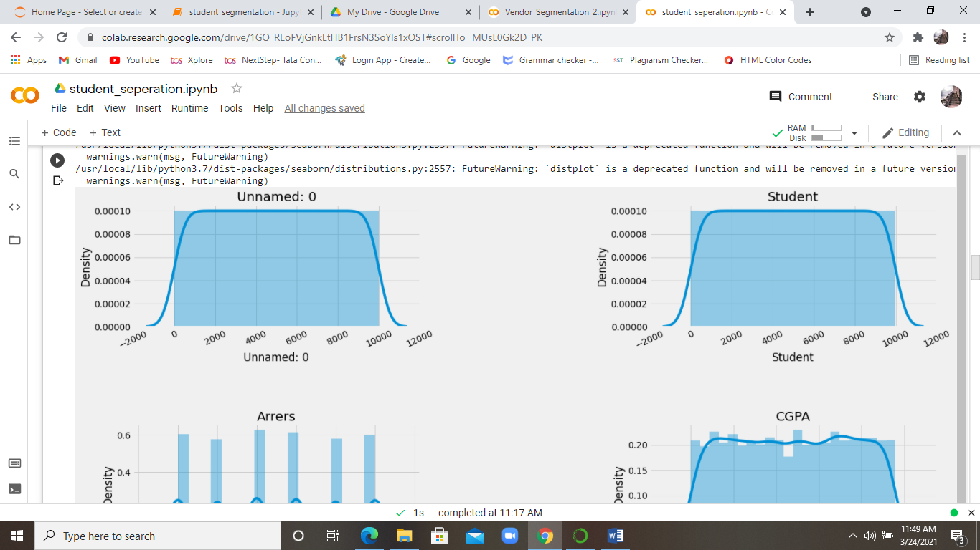
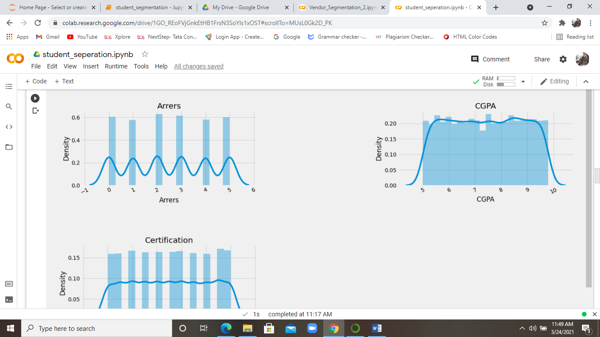
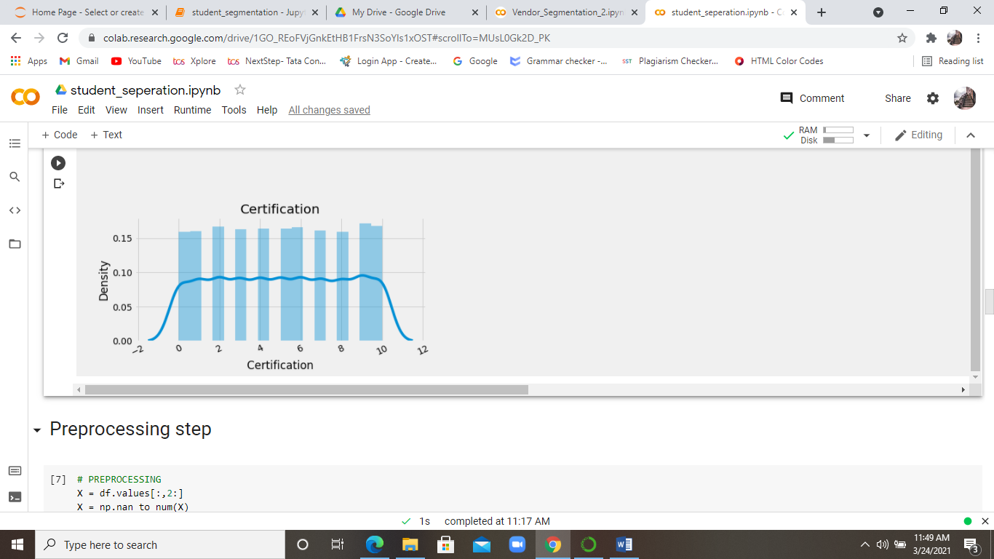

Slide 35
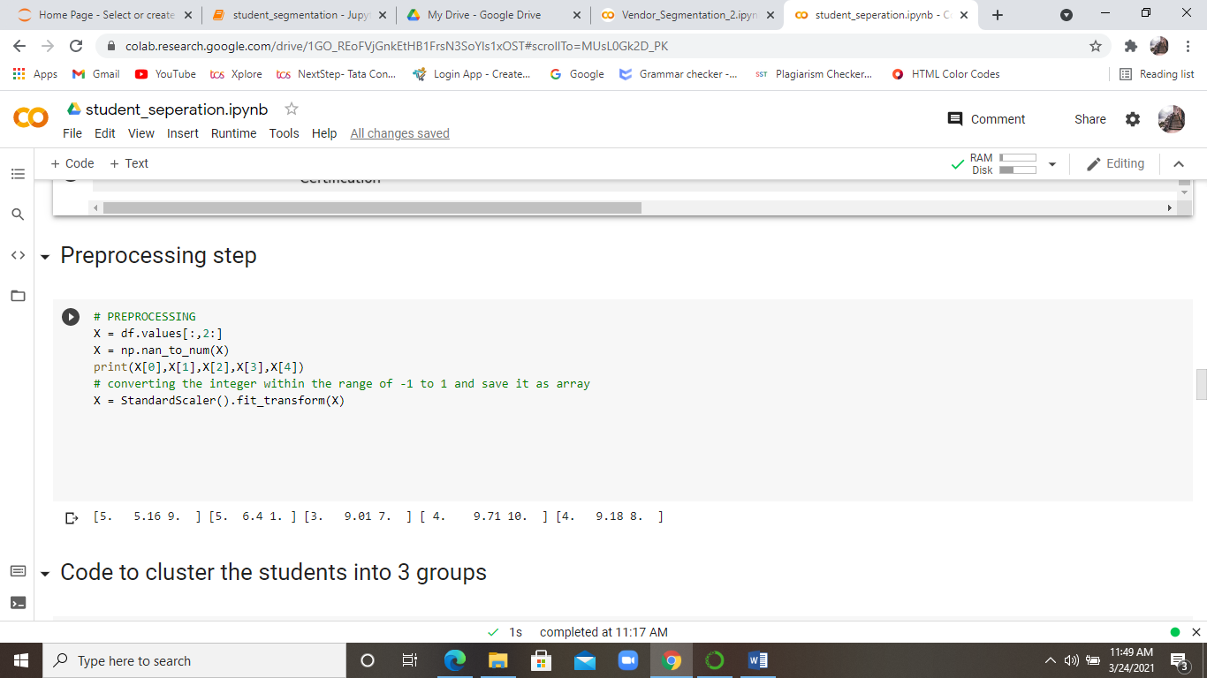
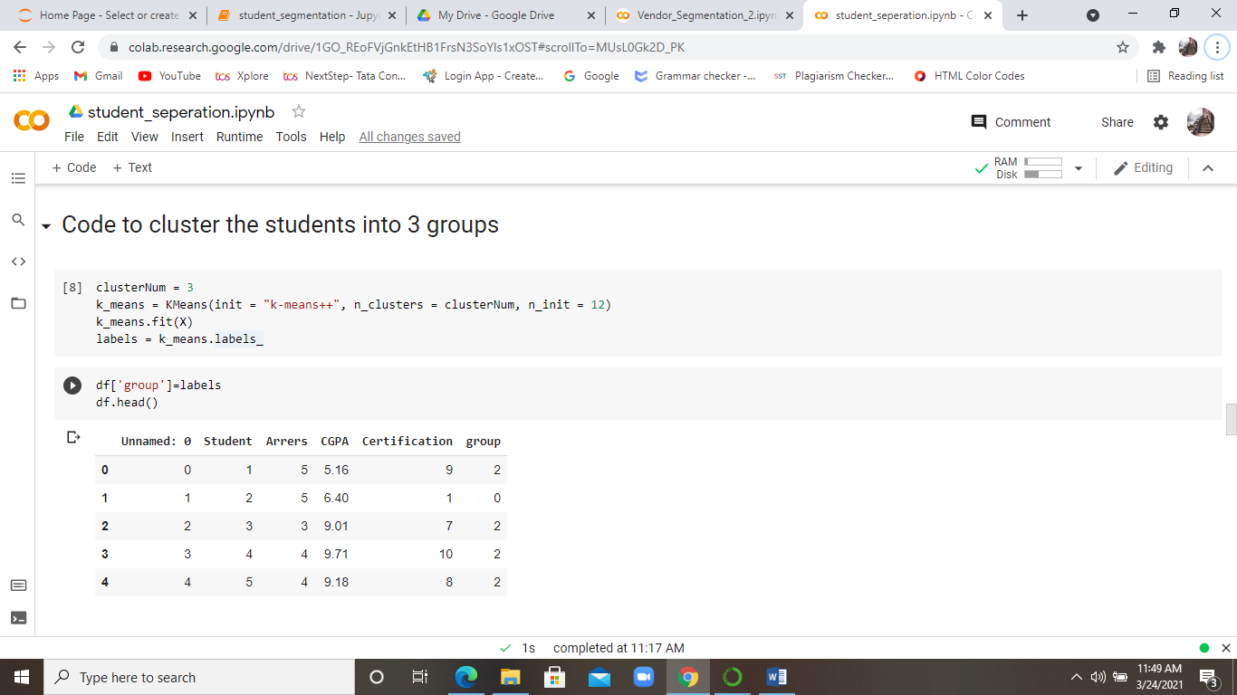

Slide 36
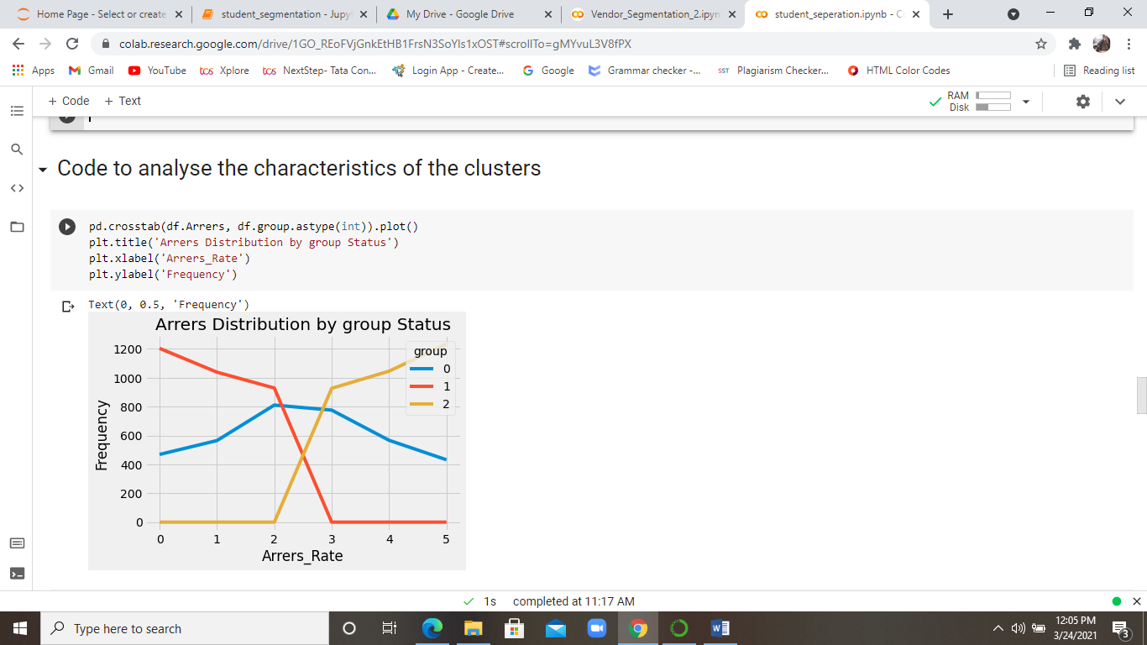
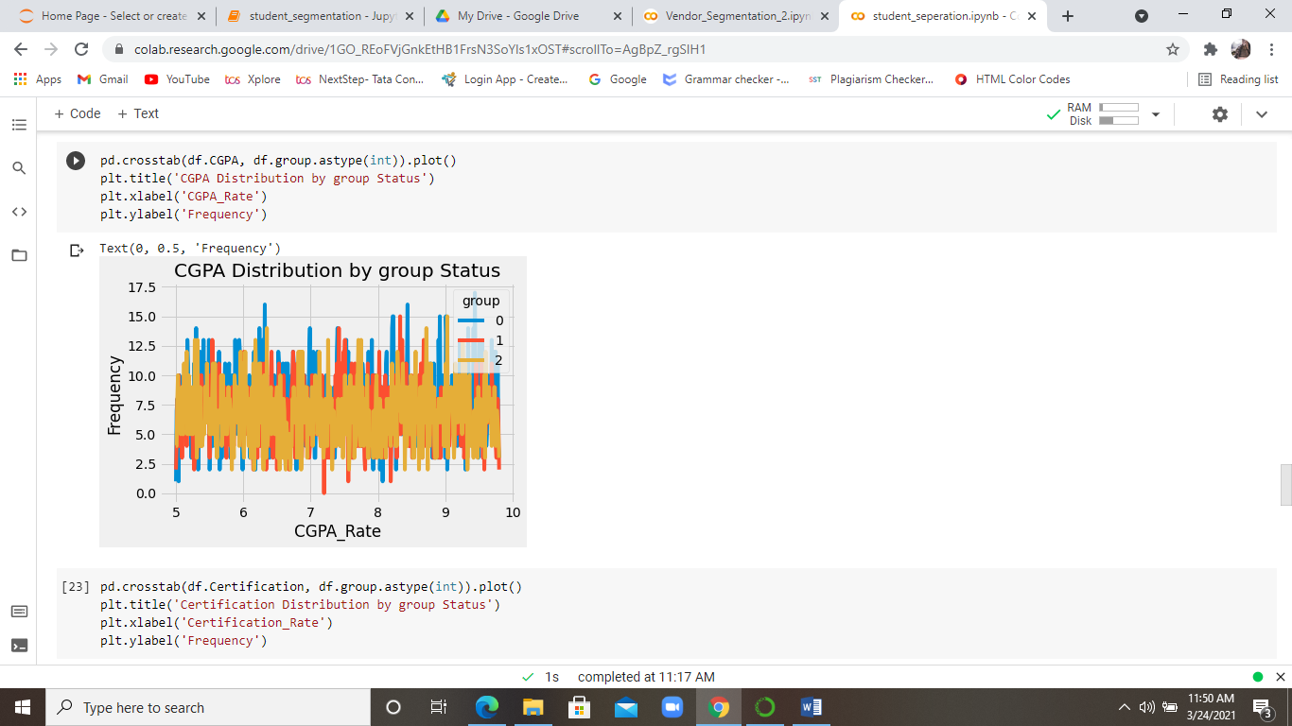
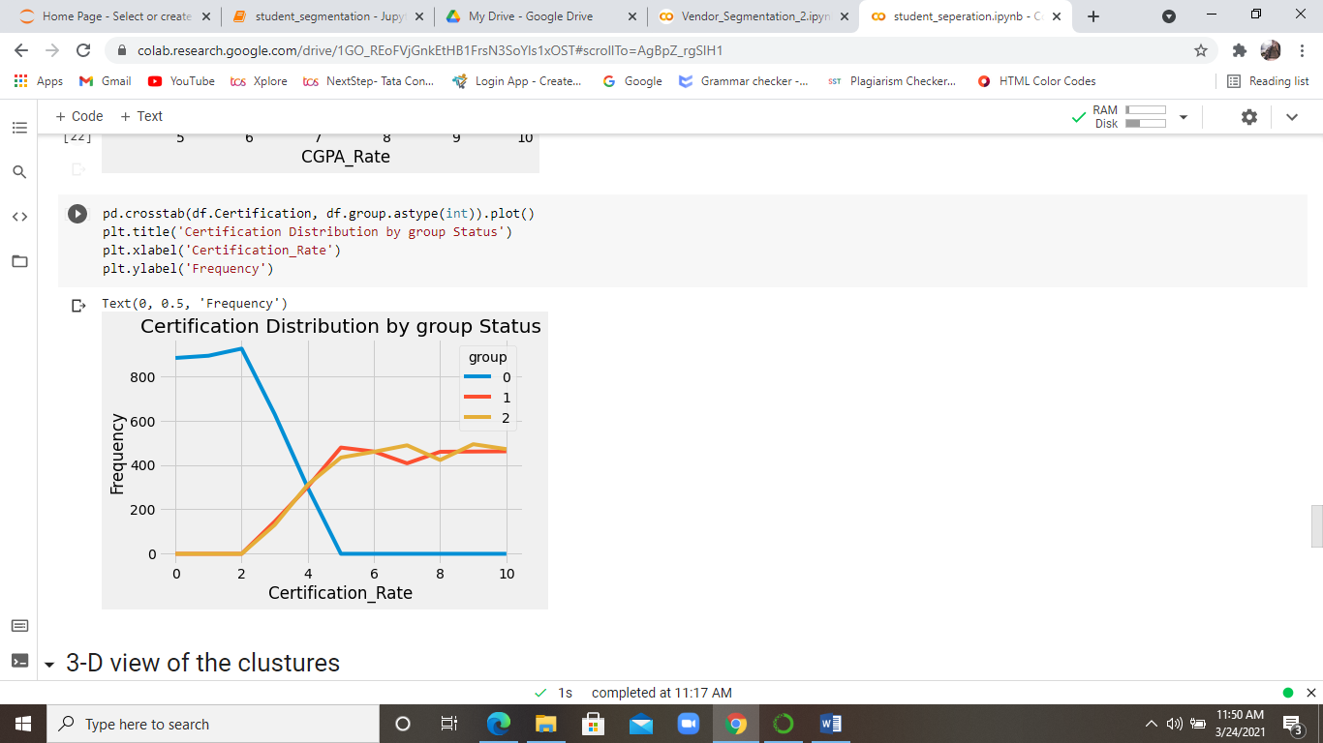

Slide 37
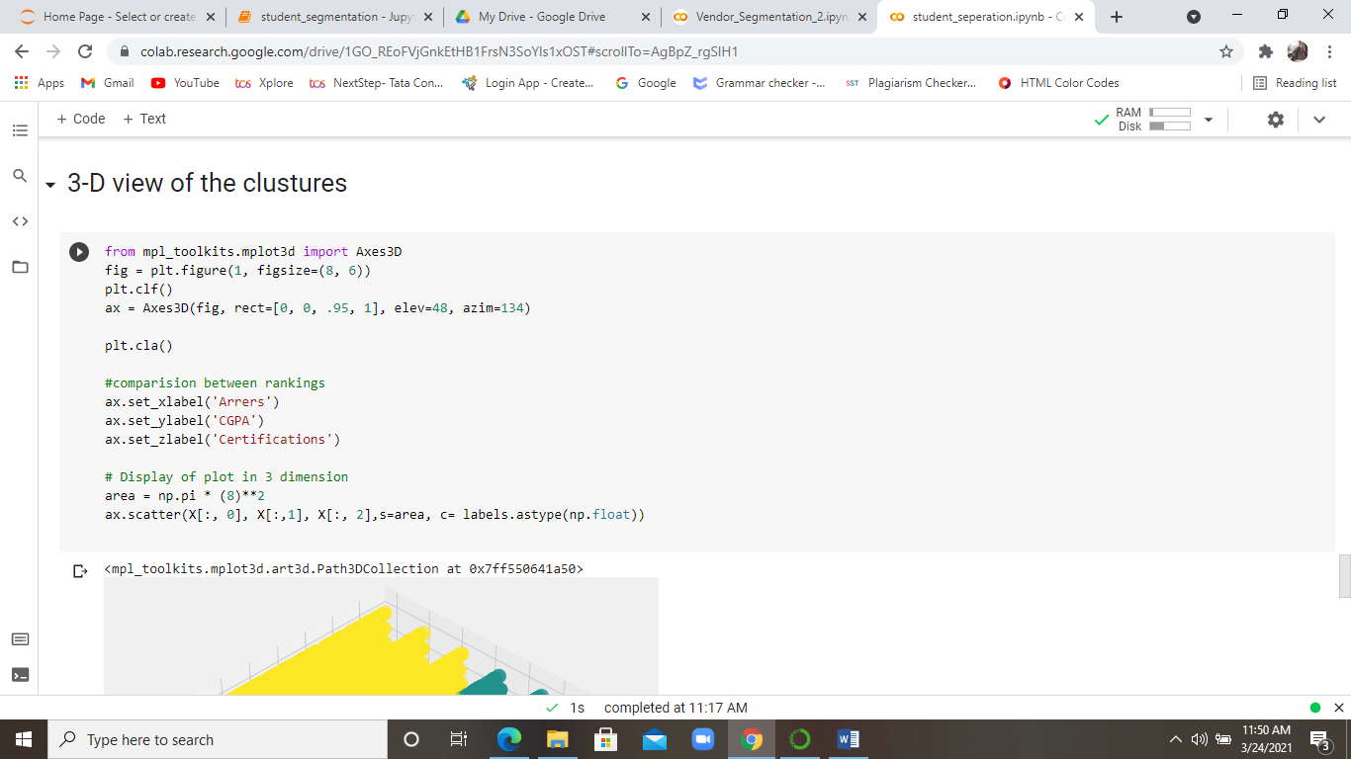
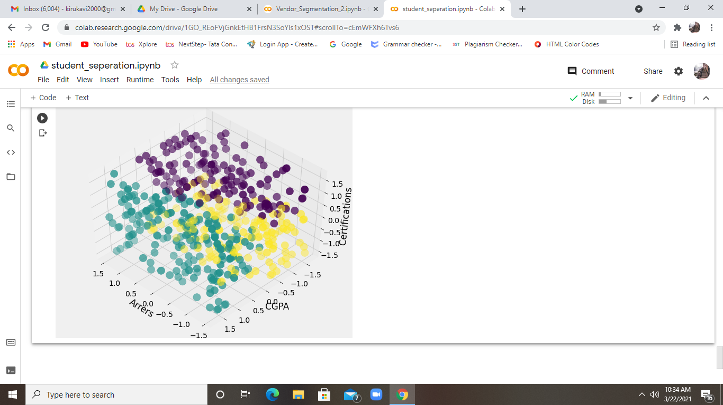

Slide 38
conclusion
Collaborative learning (digital platform) gives the best solution for students to overcome the gap between their knowledge and upcoming technology. In today’s world, sharing knowledge through the internet becomes the most effective way. This platform cultivates the habit of upskilling a student by sharing the knowledge they gain. This quality is very much needed for the companies. Students are monitored and focused by a guide to track them on the right path to gain their knowledge. Many students didn’t get enough information about what to learn, where to learn, what is expected, what is the eligibility criteria required by the companies.
This digital platform acts as a solution for all these issues and improves their skills on their own. This makes them fix enough to all the needs and requirements of the growing industrial world by choosing the correct courses at the correct time.

Slide 39
References
Zheng Ninghan, Tian Shuzhen and Chen Yongqiang (2015) Online Learning Management System, International Conference on Computational Science and Computational Intelligence
Seyed Mohammadbagher Jafari, Suha Fouad, Mohaddece Sadat Moaddab and Sharif Omar (2015) Learning Management System (LMS) Success: An Investigation Among the University Students, IEEE Conference on e-Learning, e-Management and e-Services
Chih-Hung Chung, Laura A and Chang E. Koh (2013) Web-based Learning Management System Considerations for Higher Education, Article in International Journal of Scientific and Engineering Research
Chirag Patel, Mahesh Gadhavi, Dr. Atul Patel (2013) A survey paper on e-learning based learning management Systems (LMS), Article in International Journal of Scientific and Engineering Research
Oyelade, O. J, Oladipupo, O. O and Obagbuwa, I. C (2010) Application of k-Means Clustering algorithm for prediction of Students’ Academic Performance, International Journal of Computer Science and Information Security
Slavko Rakic, Nemanja Tasic, Ugljesa Marjanovic ,Student Performance on E-Learning Platform: Mixed Method Approach (2020) International Journal of Emerging Technologies

Slide 40
Saroj, Tripti Chaudhary(2015) Study on Various Clustering Techniques, International Journal of Computer Science and Information Technologies
Kamalpreet Bindra, Anuranjan Mishra(2017) A Detailed Study of Clustering Algorithms,IEEE
Patricia Fidalgo,Joan Thormann,Oleksandr Kulyk & José Alberto Lencastre (2020)Students’ perceptions on distance education: A multinational study, Internationl Journal of Education Technology in Higher Education
Nor Azura Adzharuddin (2013) learning Management System (LMS) among University Students: Does It Work?, International Journal of e-Education e-Business e-Management and e-Learning
Shi Na, Liu Xumin and Guan Yong (2010) Research on k-means Clustering Algorithm: An Improved k-means Clustering Algorithm, Third International Symposium on Intelligent Information Technology and Security informatics.
SLAVKO RAKIC, MARKO PALVLOVIC, SELVER SOFTIC, BOJAN LALIC, UGLJESA MARJANOVIC(2019) An Evaluation of Students Performance at e-learning Platform , IEEE
ZHENFAN DING, RONG LI (2010) DESIGN OF WEB BASED RELATED E-LEARNING PLATFORM, IEEE

